Slide 1
RED WINE QUALITY
Link-https://www.kaggle.com/uciml/red-wine-quality-cortez-et-al-2009
Data- winequality-red

Slide 2
CHALLENGES IN THE PROJECT
Target variable is categorical which is multi class.

Slide 3
MAJOR FINDINGS THROUGH EDA
All the independent variable are continuous and target variable is categorical.

Slide 4
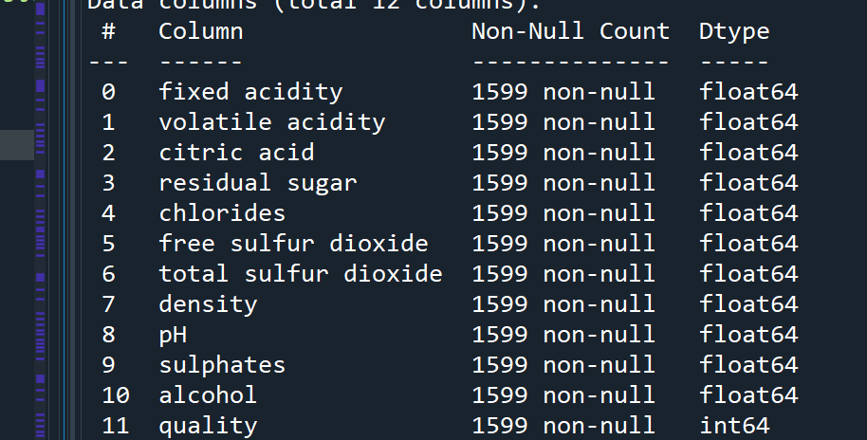
MULTI CLASS CLASSIFICATION
Shape - (1599, 12)

Slide 5
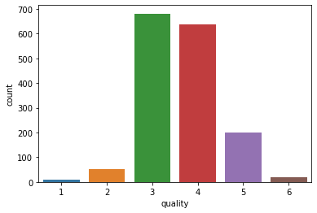
TARGET VARIABLE- ‘Quality’
Categorical variable
No null values

Slide 6
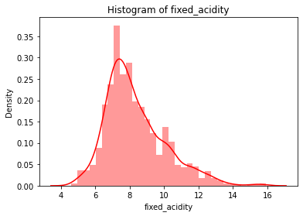
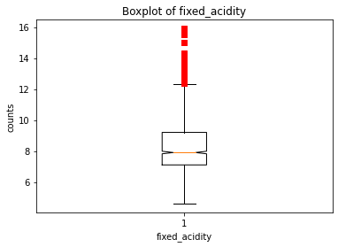
1st Variable- Fixed_acidity
Continuous variable

Slide 7
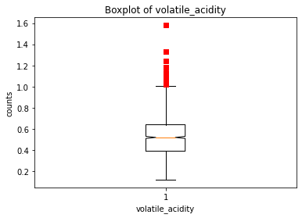
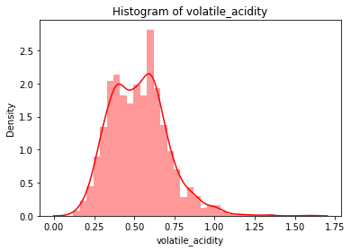
2nd Variable- Volatile_acidity
Continuous variable

Slide 8
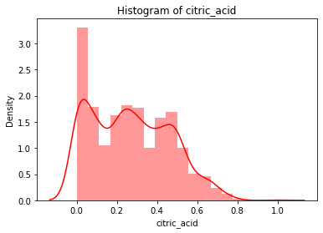
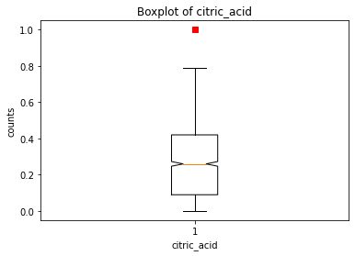
3rd Variable- Citric_acid
Continuous variable

Slide 9
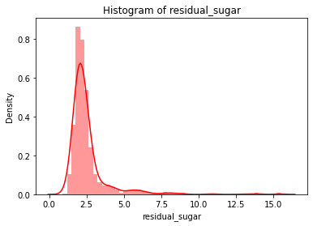
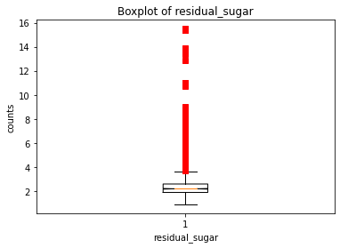
4th Variable- Residual_sugar
Continuous variable

Slide 10
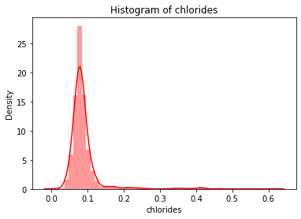
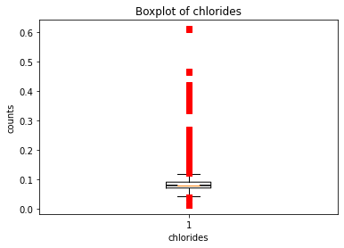
5th Variable- Chlorides
Continuous variable

Slide 11
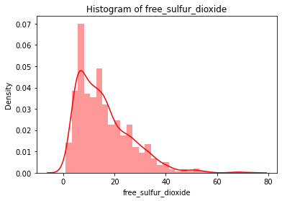
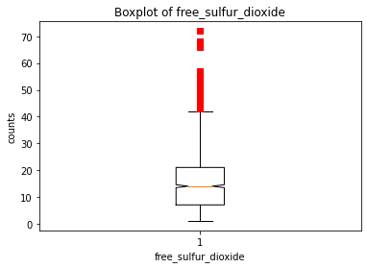
6th Variable- Free_sulfur_dioxide
Continuous variable

Slide 12
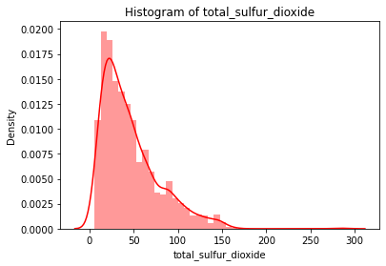
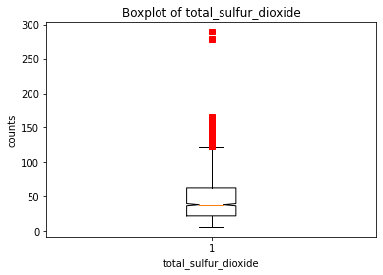
7th Variable - Total_sulfur_dioxide
Continuous variable

Slide 13
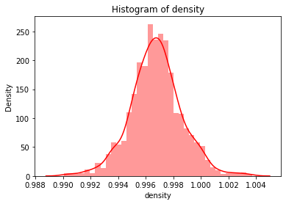
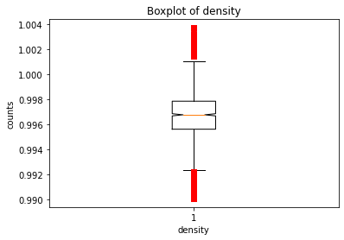
8th Variable- Density
Continuous variable

Slide 14
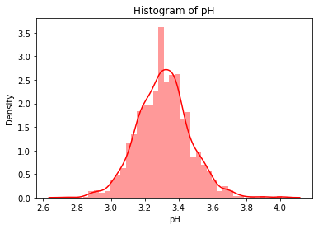
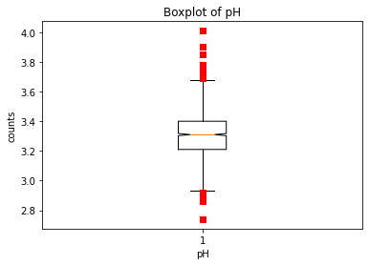
9th Variable- pH
Continuous variable

Slide 15
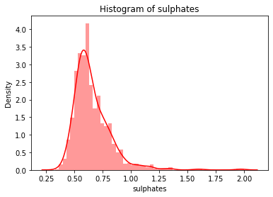
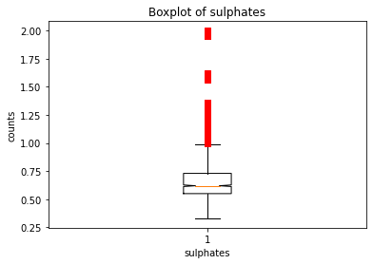
10th Variable- Sulphates
Continuous variable

Slide 16
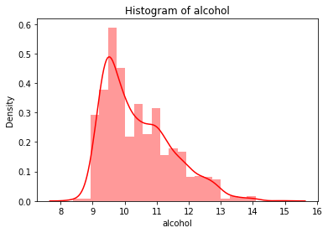
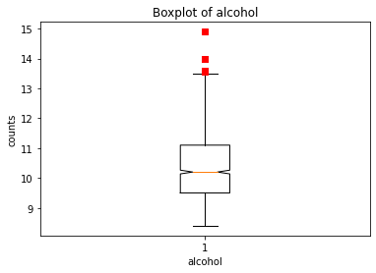
11th Variable- Alcohol
Continuous variable

Slide 17
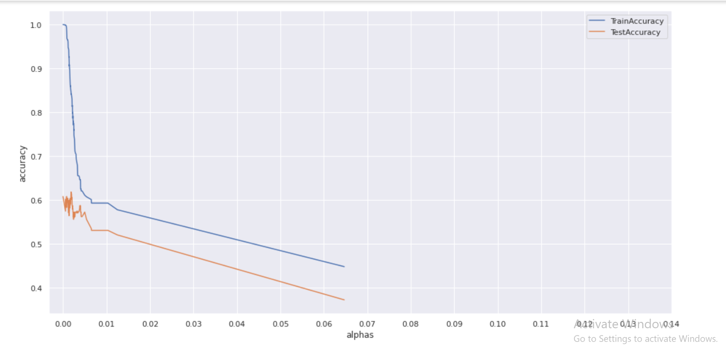
DECISION TREE

Slide 18
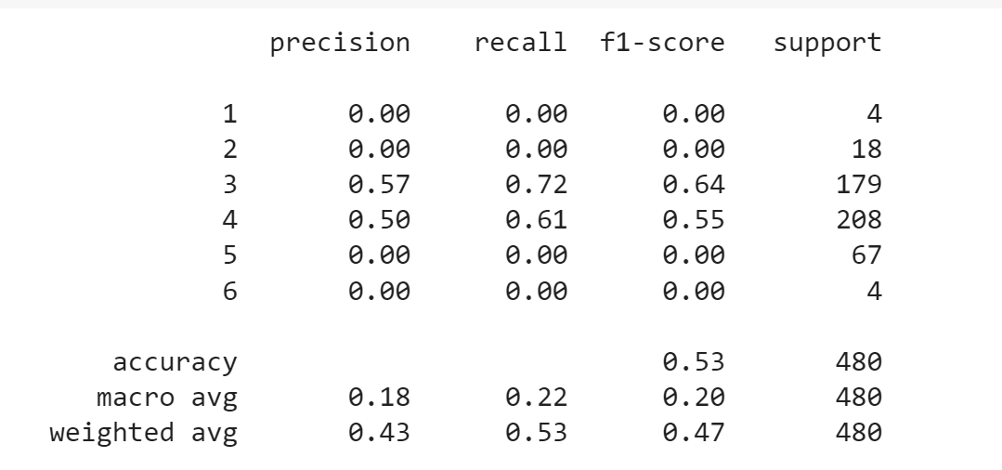
Ccp alpha= 0.01
Accuracy-
Train- 0.59
Test- 0.53

Slide 19
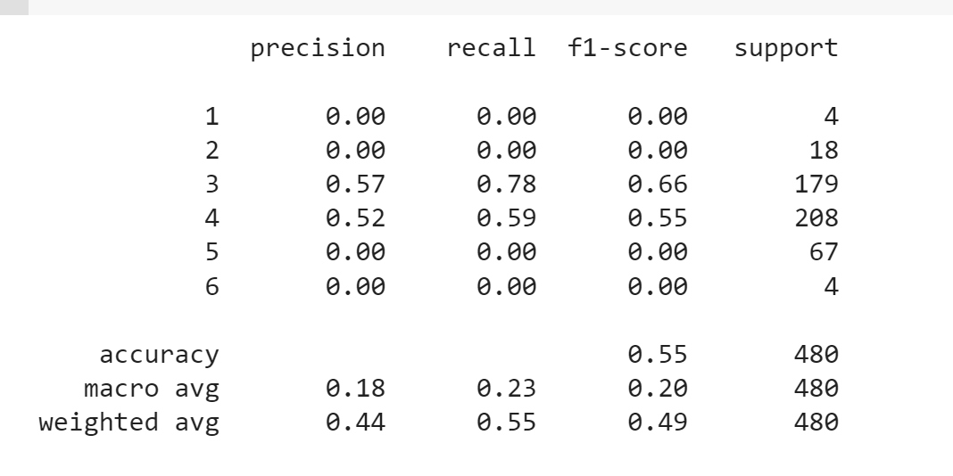
RANDOM FOREST

Slide 20
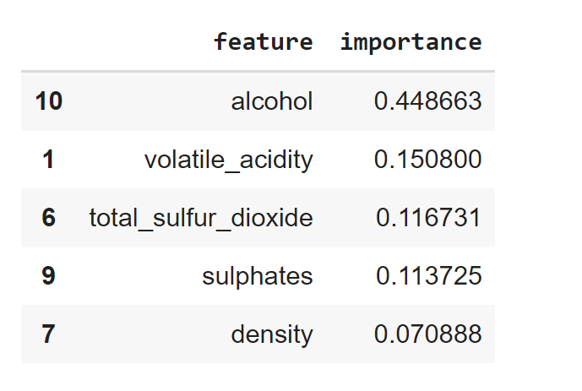
Extract Feature Importance
Accuracy
Train- 0.61
Test- 0.53

Slide 21
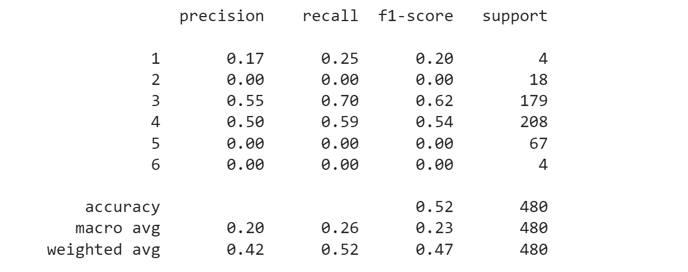
ADA BOOSTING
Accuracy
Train- 0.59
Test- 0.52

Slide 22
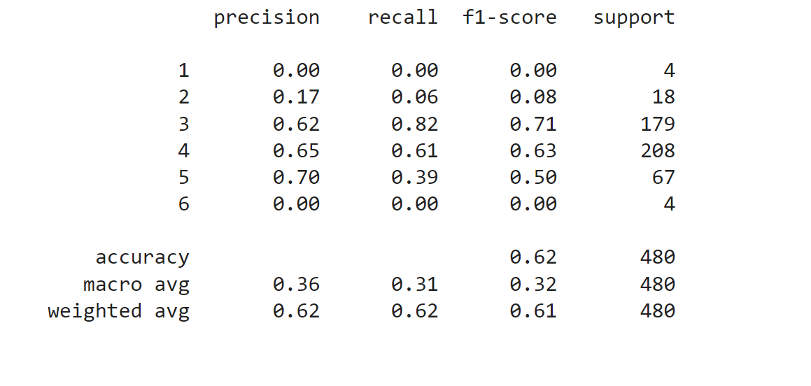
GRADIENT BOOSTING
Accuracy
Train- 0.90
Test- 0.62

Slide 23
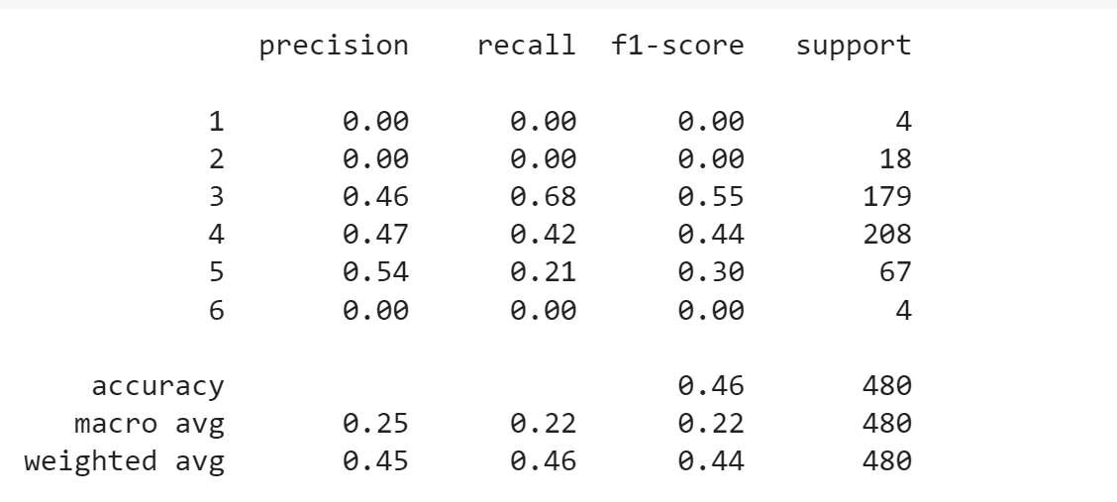
KNN
Accuracy
Test- 0.46

Slide 24
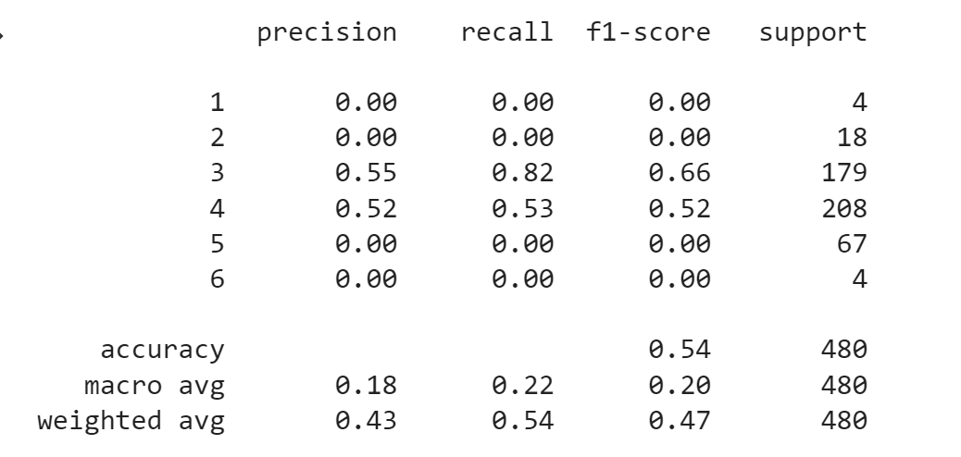
SVM
Accuracy
Test- 0.53

Slide 25
Best Model considered- Decision Tree

Slide 26
THANK YOU

